Slide 1
CS6451: Advanced Software Design
Lecture I: Interceptor Part 1
J.J. Collins
Dept. of CSIS

Slide 2
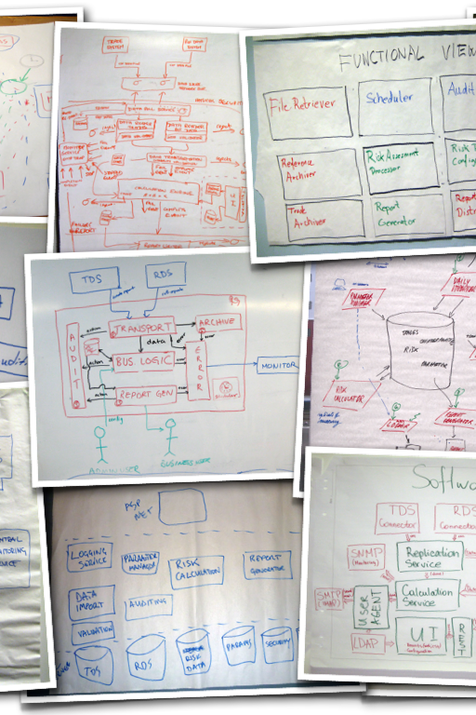
Objectives
Understand the intent, structure, collaboration, and consequences of the Interceptor architectural pattern
Advanced Software Design
© www.infoq.com

Slide 3


Oh No! NOT HIM AGAIN ….
Work clever → stay engaged
Good Practice
Attend lectures
  And stay awake
Keep up to date
Stop working to submission deadlines
  Effective time management
Reach out if in trouble

Slide 4

The Interceptor
This lecture is based on excerpts from:
Douglas C. Schmidt, Michael Stal, Hans Rohnert, and Frank Buschmann. Pattern-Oriented Software Architecture , Volume 2: Patterns for Concurrent and Networked Objects. 2000. Wiley.
  Text referred to as POSA2
Advanced Software Design
© www.infoq.com

Slide 5
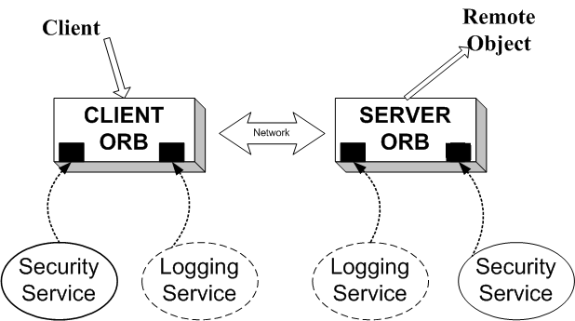
The Interceptor Architectural Pattern
A software house developing an Object Request Broker (ORB) middleware framework, based on broker architectural framework.
In addition to marshalling and unmarshalling service requests, middleware provides a basic set of services such as connection management and security.
Applications using the framework may require additional services such transaction support, load balancing, trader, logging, etc.

Slide 6
The Interceptor Architectural Pattern
Middleware Frameworks
Compiler generates stubs and skeletons
  As long as there is a language binding
Client makes a “local” call
Proxies, ORBs, and Broker do the heavy lifting
  Using an Interface Definition Language (IDL)
ORB is a kernel with core services
How can additional / out-of-band services be supported?
Client Code
(Remote) Method
Stub (Client Side Proxy)
Skeleton
(Server Side Proxy)
ORB on client machine
Broker
ORB on server machine

Slide 7
The Interceptor Architectural Pattern
Does not have to be a middleware framework
You release/sell an application
Client needs a bespoke logging service
Allow them to implement this out-of-band service by
  → building interceptor architectural pattern into application
Logging Service
Application without logging service

Slide 8
Extending the Framework
Options
Framework developers include all possible services
  Problem → Infeasible to integrate all services at design time.
Client developers include these additional/out-of-band services in their application that uses the framework API
  Problem ???
Alternatively, middleware framework is a kernel supporting core (basic) services that also facilitates transparent extension
  Through integration of services from 3rd parties.

Slide 9
The Interceptor Architectural Pattern
Context: developing frameworks that can be extended transparently
Problem:
  A framework should allow for the integration of additional services without requiring a restructuring of the system architecture.
  Should not impact existing services or applications that use the framework
  Applications using a framework may need to monitor and control the behaviour of the framework platform
    For example, some applications may use the Reflection pattern to monitor fault tolerance strategies, and modify these strategies using the Strategy pattern.

Slide 10
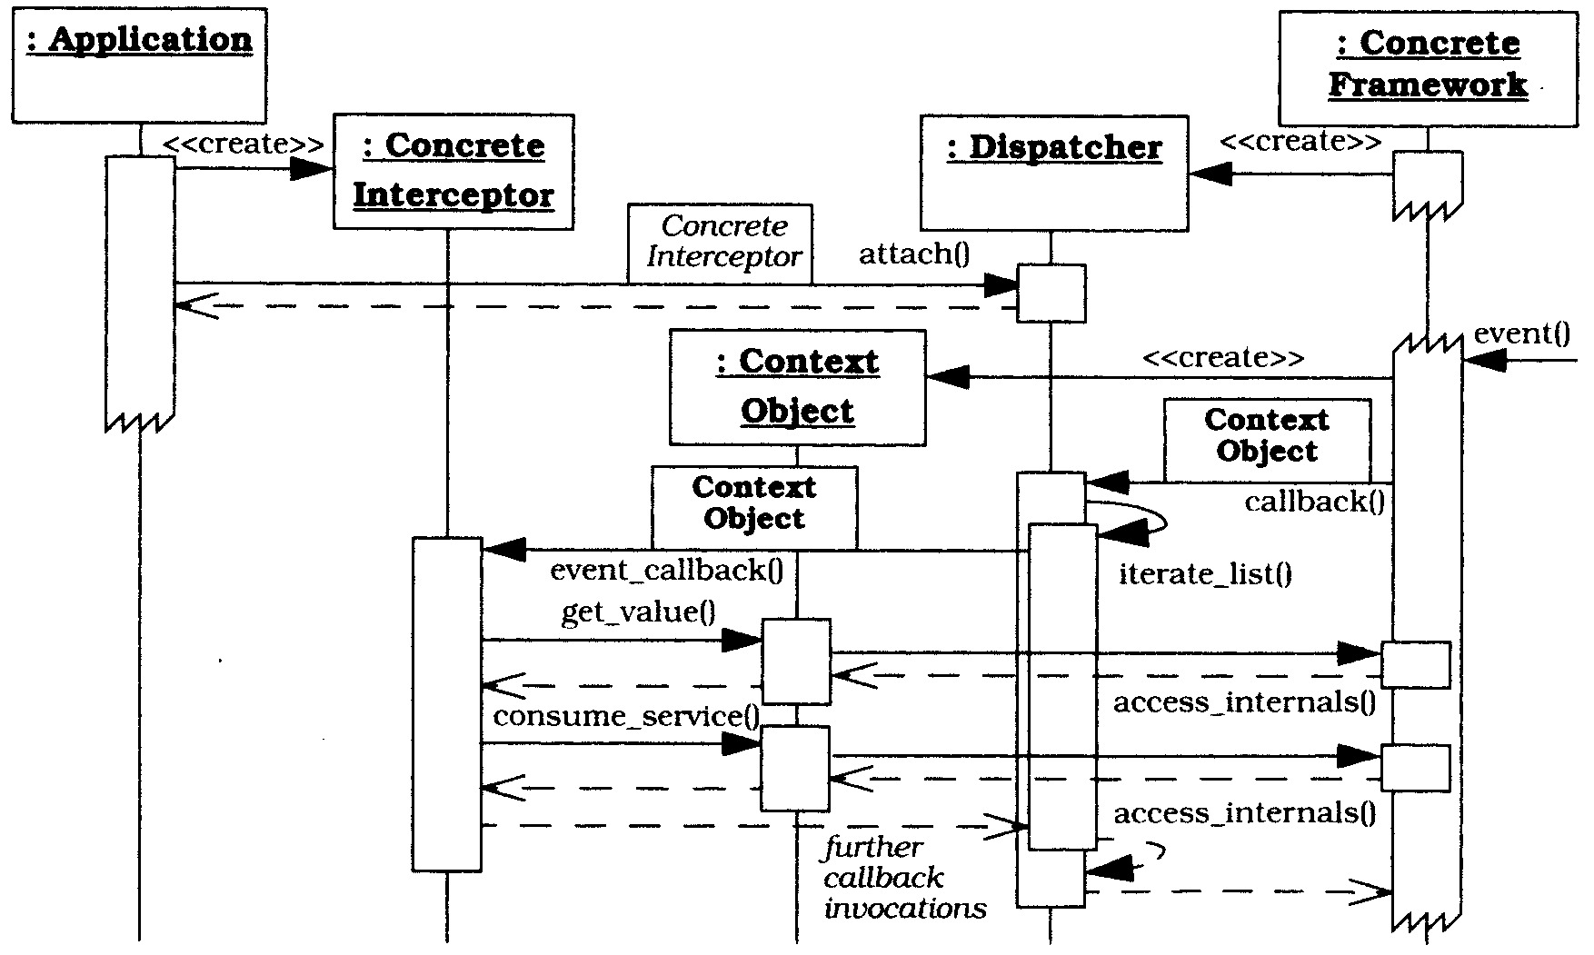
The Interceptor Architectural Pattern
Dynamics

Slide 11
The Interceptor Architectural Pattern
Framework (ORB) creates dispatcher(s)
  One or many?
Application creates concrete interceptors (out-of-band services) and registers them with dispatcher
  What is the interceptor interface?
  Who implements the interceptor?
In response to an event the framework
  Creates a Context Object – a handle that allows the out-of-band service to query and control the framework
    What is the API for the Context Object?
  The frameworks CALLS BACK to the dispatcher passing a reference to the context object
    How is the callback implemented?
  The dispatcher CALLS BACK to its registered concrete interceptors passing a reference to the Context Object
  The concrete interceptor can then query the framework and invoke framework services via the Context Object

Slide 12
The Interceptor Architectural Pattern
Solution
“Out-of-band” services register with the framework by predefined interfaces.
Framework triggers these out-of-band services when certain events fire.
Open the framework’s implementation so that out-of-band services can access and control certain aspects of the framework’s behaviour.
For a specified set of events that are processed by framework, define and expose an interceptor callback interface
Applications can derive concrete interceptors from this interface to implement out-of-band services that process these said events.
Provide a dispatcher that allows applications to register their concrete interceptors with the framework.

Slide 13
The Interceptor Architectural Pattern
When an event occurs, the framework notifies the appropriate dispatcher to invoke the callback of the registered concrete interceptor.
The Command design pattern (behaviour) is an object-oriented pattern for callbacks.
Define context objects to allow a concrete interceptor to introspect and control certain aspects of the framework.
Context objects provide methods to access and modify a framework’s internal state.
Can be passed to concrete interceptors when they are dispatched by the framework.

Slide 14
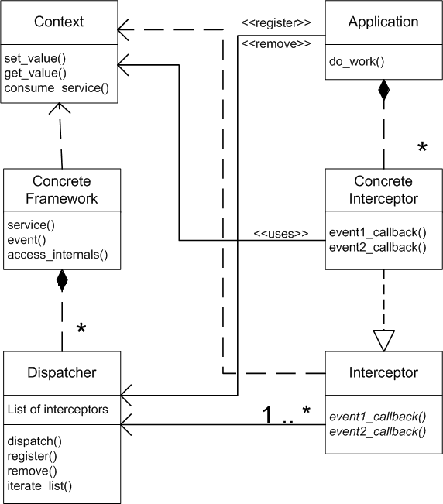
The Interceptor Architectural Pattern
STRUCTURE

Slide 15
The Interceptor Architectural Pattern
Class: Concrete Framework
Collaborator: Dispatcher
Responsibility:
  Defines application services.
  Integrates Dispatchers that allow applications to intercept events.
  Delegates events to associated dispatchers.
Class: Interceptor
Collaborator:
Responsibility:
  Defines an interface for out-of-band services.

Slide 16
The Interceptor Architectural Pattern
Class: Concrete Interceptor
Collaborator: Context Object
Responsibility:
  Implements a specific out-of-band service.
  Uses context object to control the concrete framework.
Class: Dispatcher
Collaborator: Interceptor, Application
Responsibility
  Allows applications to register and remove concrete interceptors.
  Dispatches registered concrete interceptor callbacks when events occur.

Slide 17
The Interceptor Architectural Pattern
Class: Context Object
Collaborator: Concrete Framework
Responsibility:
  Allows services to obtain state information from the concrete framework.
  Allows services to control certain behaviours in the concrete framework.
Class: Application
Collaborator: Dispatcher, Concrete Interceptor
Responsibility:
  Runs on top of the concrete framework.
  Instantiates concrete interceptors and registers them with dispatchers.

Slide 18
The Interceptor: Consequences
Benefits:
Extensibility & flexibility
  Interceptors allow an application to evolve without breaking existing APIs & components
Separation of concerns
  Interceptors decouple the “functional” path from the “meta” path
Support for monitoring & control of frameworks
  e.g., generic logging mechanisms can be used to unobtrusively track application behaviour
Layer symmetry
  Interceptors can perform transformations on a client-side whose inverse are performed on the server-side
Reusability
  Interceptors can be reused for various general-purpose behaviours

Slide 19
The Interceptor: Consequences
Liabilities:
Complex design issues
  Determining interceptor APIs & semantics is non-trivial
Malicious or erroneous interceptors
Potential interception cascades
  Interceptors can result in infinite recursion

Slide 20
The Interceptor: Consequences
Benefits:
Extensibility & flexibility
  Interceptors allow an application to evolve without breaking existing APIs & components
Separation of concerns
  Interceptors decouple the “functional” path from the “meta” path
Support for monitoring & control of frameworks
  e.g., generic logging mechanisms can be used to unobtrusively track application behaviour
Layer symmetry
  Interceptors can perform transformations on a client-side whose inverse are performed on the server-side
Reusability
  Interceptors can be reused for various general-purpose behaviours

Slide 21
Known Uses
All middleware platforms
Glassfish
  https://glassfish.java.net/docs/v3/api/javax/interceptor/package-summary.html
Apache Tomcat
  http://tomcat.apache.org/tomcat-6.0-doc/config/cluster-interceptor.html
Document Interceptor for Sharepoint
  http://www.archibus.com/ai/abizfiles/v19.3_help/system-management-help/Content/web_services/webservices_example7.htm
Microsoft Internet Explorer to register plugins for specific media types.

Slide 22
The Interceptor Architectural Pattern
Seven steps to implement the Interceptor Architectural Pattern:
Model the Internal Behaviour of the Framework
Identify and Model Interception Points
Specify the Context Objects
Specify the Interceptors
Specify the Dispatchers
Implement the Callback Mechanisms in the Concrete Framework.
Implement the Concrete Interceptors

Slide 23

Homework
Lookup the interceptor.
Study lecture notes on interceptor.
Draw sequence diagram without referring to the notes.
Advanced Software Design
© www.infoq.com

